Slide 1
Memory Hierarchy
Cache Memories
Program Optimization
MADE BY: Sun Shaocong & Shi Zhuming
THANKS TO: Zhong Zhineng & Song Yixin

Slide 2
Memory Hierarchy

Slide 3
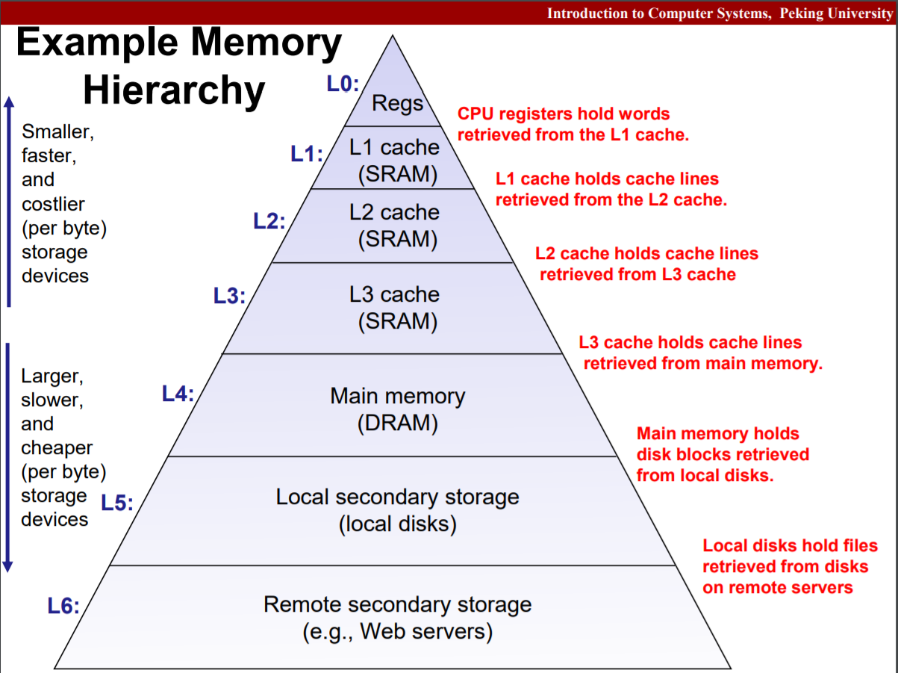
Example

Slide 4
Storage Technology
RAM: SRAM & DRAM
Disk
Bus structure

Slide 5
RAM
Random Access Memory (RAM)
Volatile, expensive, compared to hard disk
SRAM versus DRAM
SRAM doesn’t need refresh
faster and stable, more expensive
used as cache memories
DRAM
higher density, lower power consumption
used as main memory

Slide 6
DRAM: Access
Row Access Strobe (RAS)
Column Access Strobe (CAS)
Memory module: Read & Write a word
FPM DRAM, SDRAM, DDR SDRAM

Slide 7
ROM
nonvolatile, compared to RAM
PROM: only programmed once
EPROM
EEPROM -> flash memory
firmware: stored in ROM

Slide 8
BUS
Bus transaction: read and write
System bus: connecting CPU and I/O bridge
Memory bus: connecting I/O bridge and main memory
I/O bus: disk, graphic card and other buses

Slide 9

DISK
Capacity:
$Capacity = \left(\#\frac{bytes}{sector}\right)∗ \left( \#\frac{avg. sectors}{track}\right)∗ \left(\#\frac{tracks}{surface}\right)∗ \left(\#\frac{surfaces}{platter}\right)∗ \left(\#\frac{platters}{disk}\right)$
Access time:
avg seek time + avg rotation time + avg transfer time

Slide 10

Unit Conversion
K(kilo), M(mega), G(giga), T(tera): context dependent
DRAM & SRAM: ${K=2}^{10}$, ${M=2}^{20}$, ${G=2}^{30}$, ${T=2}^{40}$
Disk & network: ${K=10}^{3}$, ${M=10}^{6}$, ${G=10}^{9}$, ${T=10}^{12}$

Slide 11
SSD
Solid State Disk (SSD)
Sequential access faster than random access
Write slower than Read
Modifying a block page requires full page erasure and copy

Slide 12
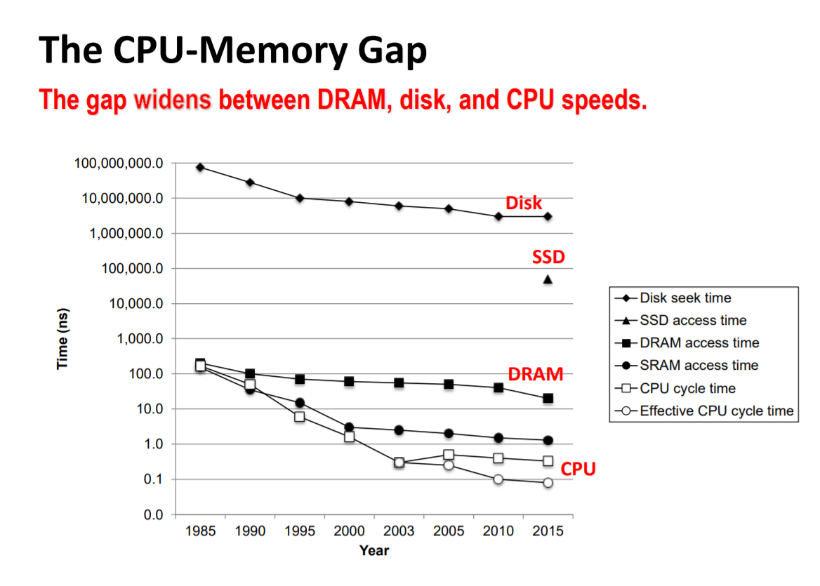
Developing Tendency

Slide 13
Locality
Temporal locality
Spatial locality
Data-access: temporal locality or spatial locality:
The smaller the step length, the better the spatial locality.
Repeating references to the same variable has the temporal locality.
Instruction-fetch: both locality:
The smaller the loop body and the more the number of iteration, the better the locality.

Slide 14
Cache Memories

Slide 15
Cache Memories
Small and fast SRAM memories
Keep frequently accessed blocks of main memory
Cache hit
Cache miss: three types of miss

Slide 16
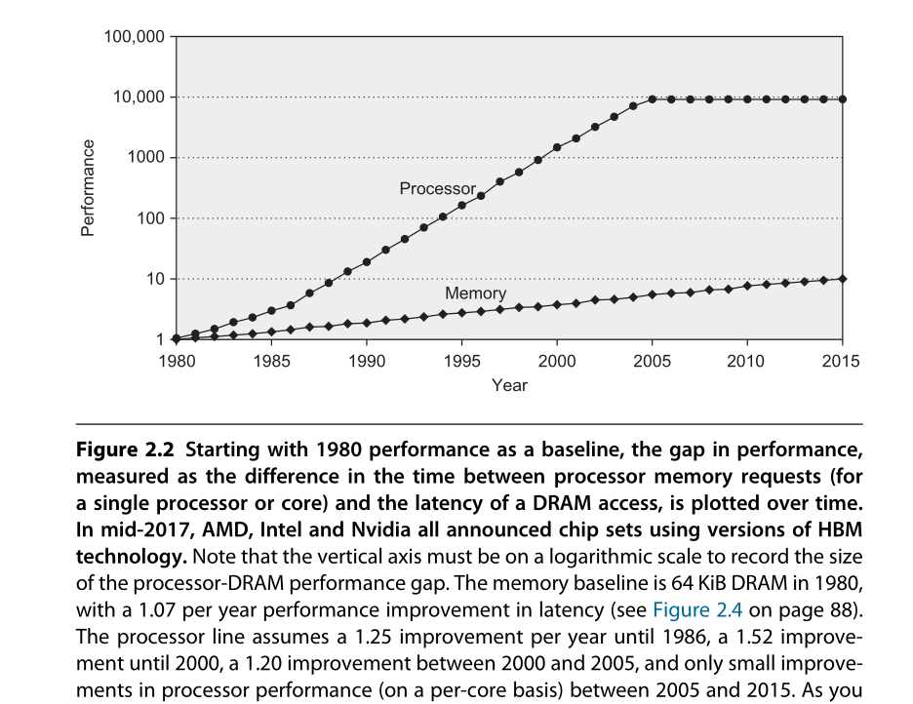

Slide 17
Cache Structure
M, S, E, B, m, s
S cache sets, E cache lines, B blocks
t = m-(b+s) tag bits
Valid bit
C = S×E×B
Address of word: tag + set index + block offset
Bijection from middle s set index bits to S cache sets
Bijection from low b block offset bits to B blocks
2^t address of a cache set => t tag bits

Slide 18
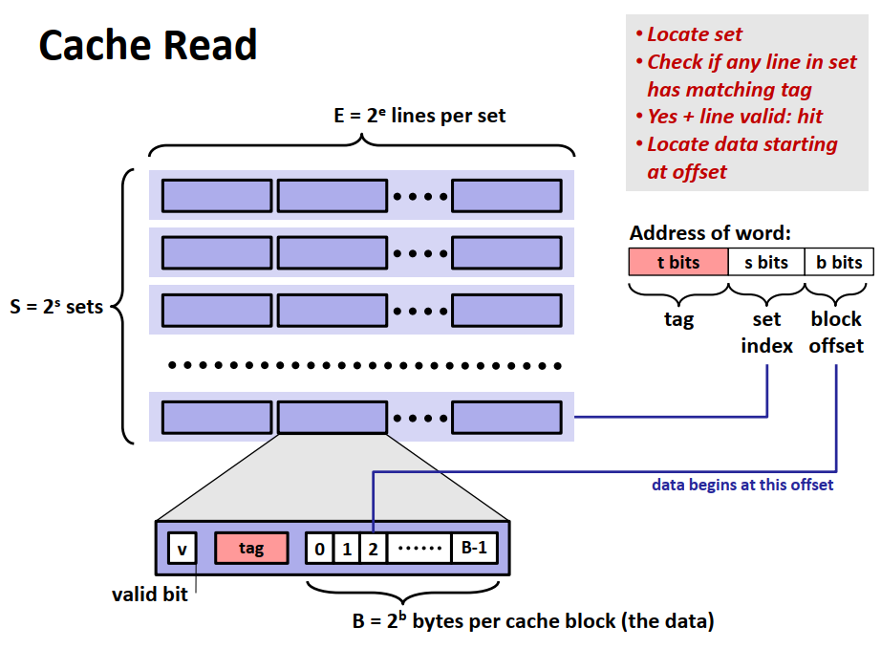
Cache Structure

Slide 19
Cache Classification
Direct Mapped Cache (E = 1)
Not match: old line being replaced directly
Thrash
Associative Cache (1 <E < C/B)
Not match: one line in the set is selected for eviction and replacement
Many replacement policies: Random, LRU, LFU, …
Fully Associative Cache (S = 1, E = C/B)
Search for many matching tags in parallel => expensive and small
TLB

Slide 20
Cache Write
Write hit
Write-through
Write-back
Write miss
Write allocate
No write allocate
Write through + No write allocate / Write back + Write allocate

Slide 21
Cache Friendly Code
Make use of locality
Make the most frequent the fast
Decrease cache miss within loops
Loop variable orders

Slide 22
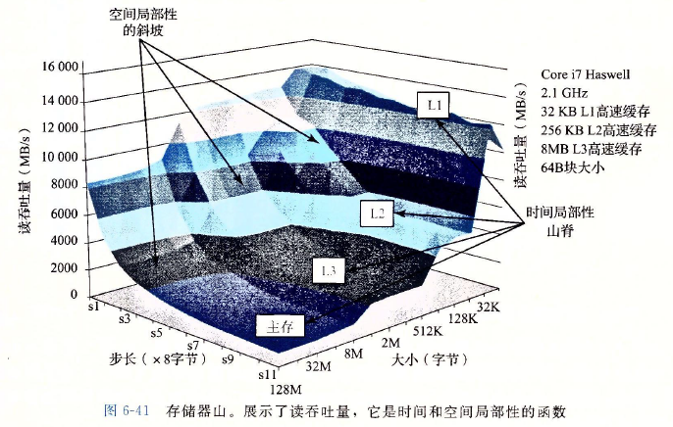
Cache Mountain

Slide 23
Program Optimization

Slide 24
Compiler Optimization
Some can be done by compiler
Code moving, such as moving the repeating calc inside the loop outside.
Use shift and add/sub to do mult/div
Expression reuse
Some cannot be done by compiler (must be conservative)
Procedure may have side-effects
Pointer may have aliases

Slide 25
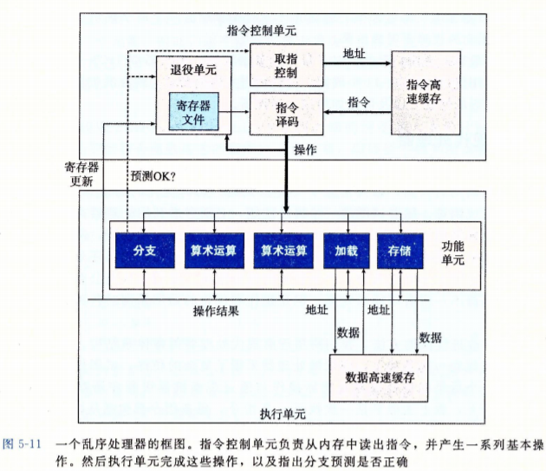
Simple Out-of-order Processor
CPI may be less than 1
In-order issue
Out-of-order execution
In-order commit

Slide 26
Modern CPU
Out-of-order execution
Multiple issue
Dynamic Scheduling
Speculative execution
Register renaming

Slide 27
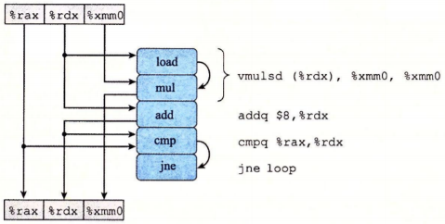
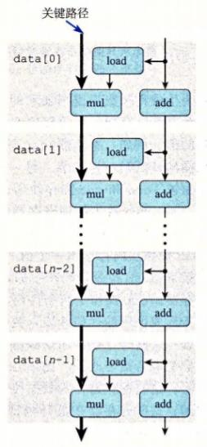
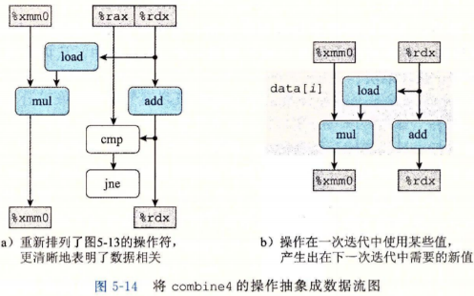
Critical Path
Critical path: lower bound
Number of function parts
Data passing limitation

Slide 28
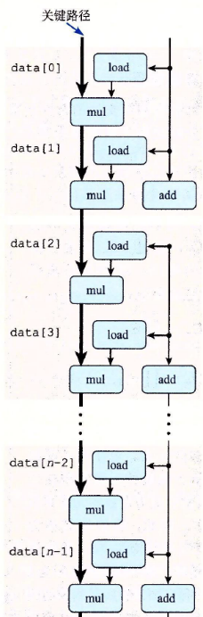
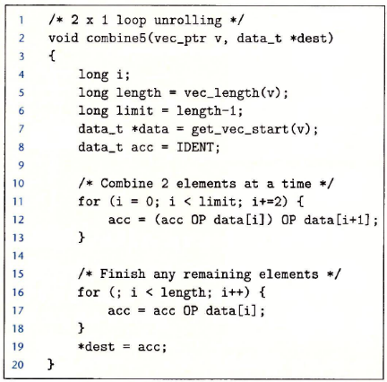
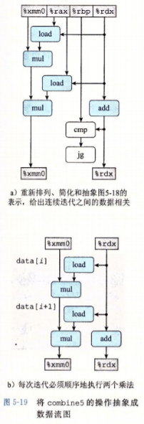
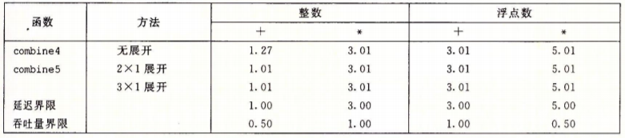
Loop Unrolling: Improve Parallelism

Slide 29
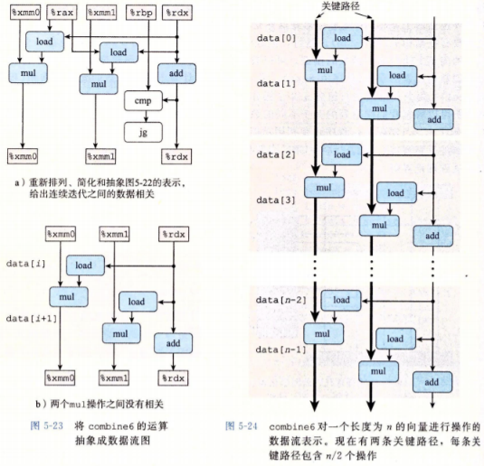
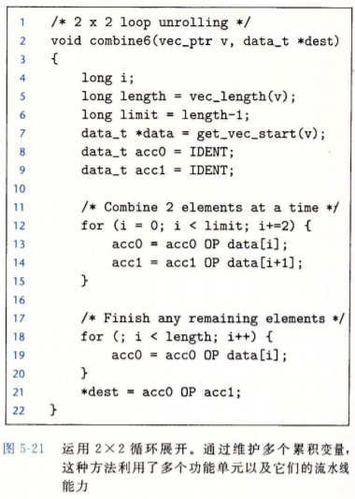
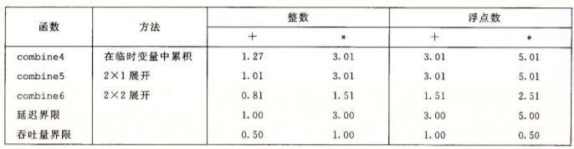
Separate Accumulators

Slide 30
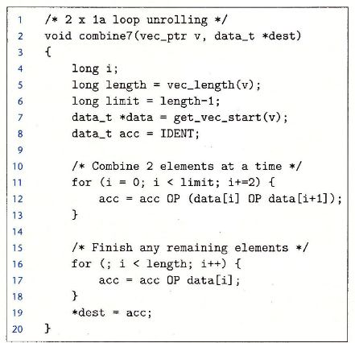
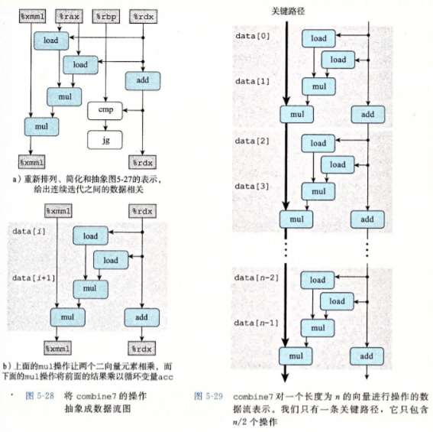
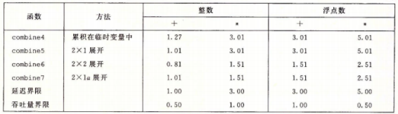
Reassociation

Slide 31
Limitations
Register spilling: k = 20, use stack to store
Floating operation does not have associative law, so changing operation orders may not apply.

